Slide 1
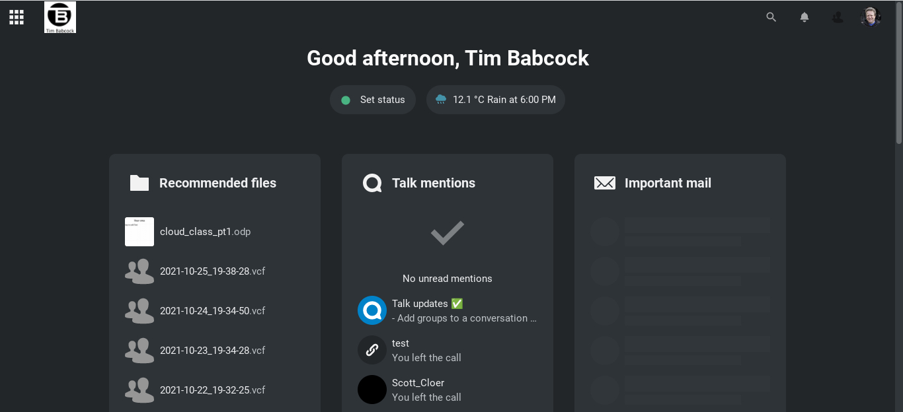
Nextcloud Part 1

Slide 2
Using this video series
This video can be paused, stopped, or played back at anytime
This video is intended for personal use only and isn’t intended for public viewing or distribution outside of this website.
This information being presented isn’t approved by the developer.

Slide 3
Why your own cloud server?
Security
Backing up your phone to your own computer
Lack of SD card in mobile device
Having a secondary computer
Managing all you files from one device
No subscription fees
Easy to use and upgrade as needed

Slide 4
What is covered in the series
1st video will cover hardware and Linux setup
2nd video will cover Nextcloud app setup
3rd video will cover troubleshooting and maintenance

Slide 5
Recommended viewing
If you aren’t familiar with home networking, please watch this video on the website:
https://www.timbabcock.net/home_networking.aspx
This video series will cover port forwarding that can be administered on networking equipment not provided by your ISP

Slide 6
Hardware

Slide 7
Required Hardware
Raspberry Pi 4 B with 8 gb of Ram
(4gb version can be used if you have another device to run the database server)
USB 3.0 hard drive that isn’t solid state to accommodate storage (2TB is recommended)
(solid state hard drives aren’t recommended to run a cloud or database server)
128-256gb Micro SD card
(SanDisk is recommended)

Slide 8
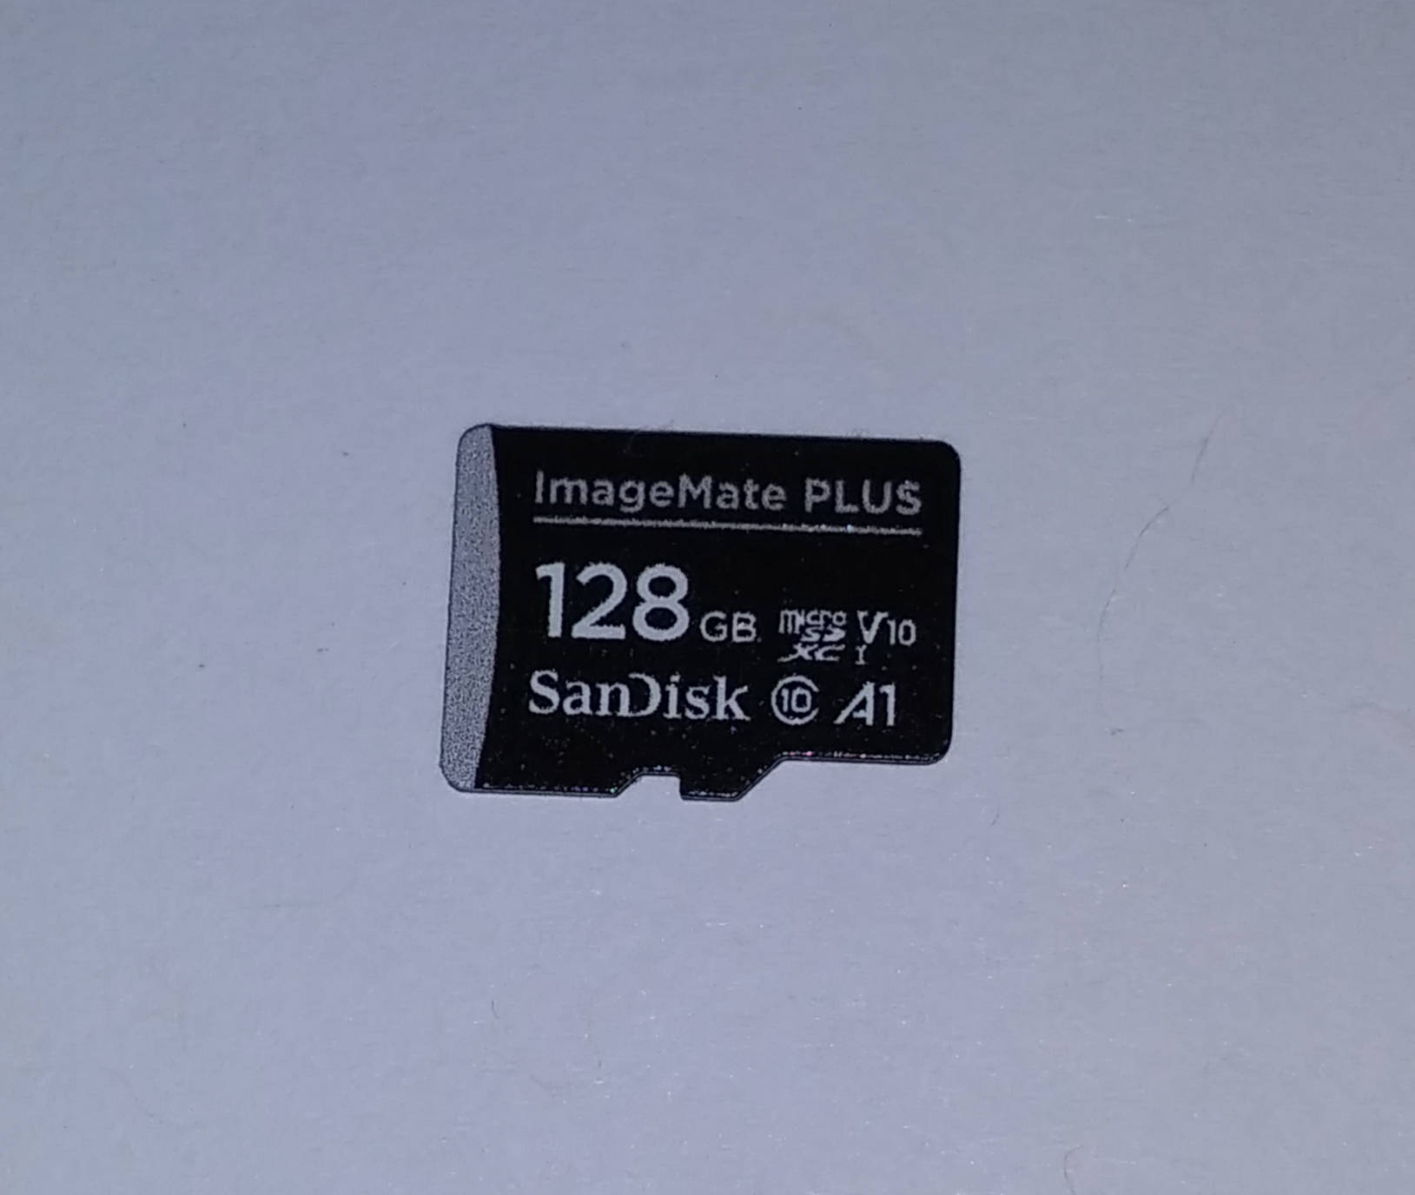
SD Card
Class 10 A1 card is recommended for fast reading and writing access.
San Disk Extreme cards aren’t necessary for this application.
SD cards greater then 512 GB will reduce computer performance.

Slide 9
Additional Hardware
Network Router
Enclosure for Raspberry Pi
Power supply for Raspberry Pi
Ethernet cable
Micro HDMI cable
HDMI television (1080 or 720 is recommended)
USB keyboard (wired or wireless)

Slide 10
You may need
USB 3.0 Hub with AC power
(if your USB 3.0 hard drive doesn’t require an AC adapter)
Computer to create Ubuntu image on SD card
(Windows, Mac, Linux)
USB 3.0 SD card reader to create image on SD card
(make sure it is made for your SD card (high capacity format))

Slide 11
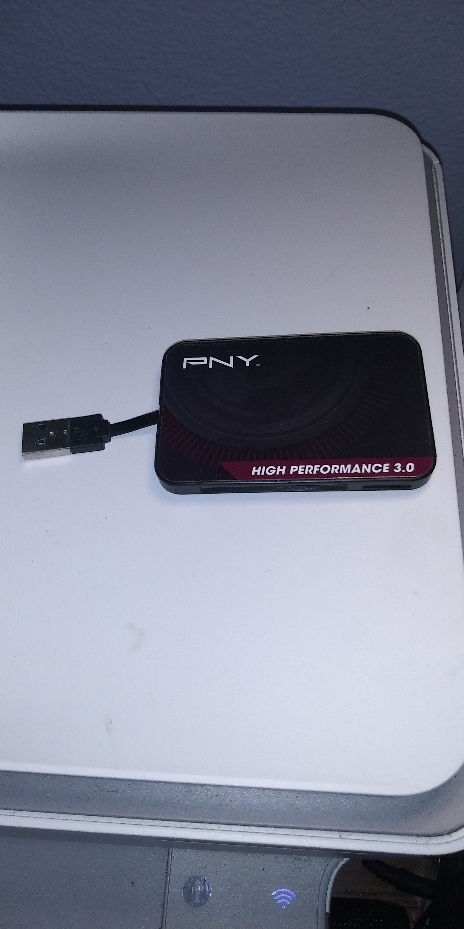
USB 3.0 Card Reader

Slide 12
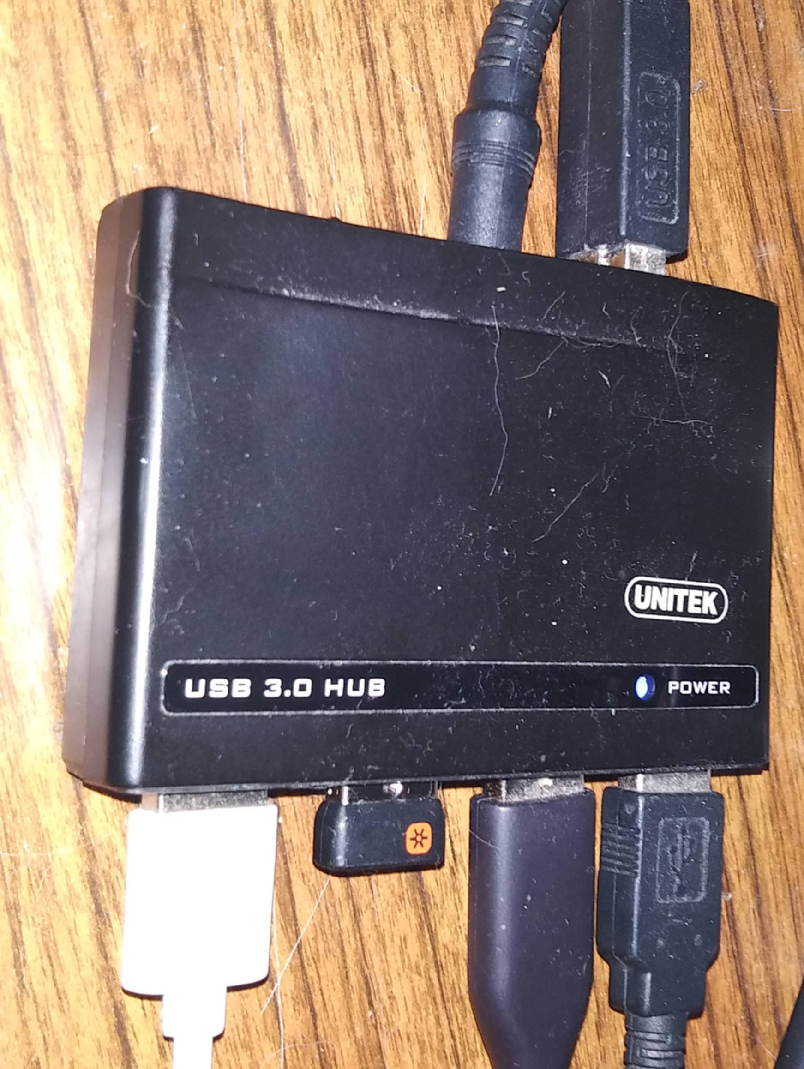
USB 3.0 Hub
Connect USB 3.0 Hard Drive to USB hub to provide power to the hard drive and Raspberry Pi.
(Recommended if the hard drive doesn’t have a separate power supply)
If powering on the Raspberry Pi, make sure USB hub is turned off. One booted, turn USB hub back on.

Slide 13
Servers

Slide 14
What happens on cloud servers
Synchronizing information between devices including servers, desktop computer, and mobile devices.
Email services
Video conference services
Adding, editing, and collaboration of office files (documents, spreadsheets, and presentations)

Slide 15
Cloud services can take more than one server to operate
1 server can run the server application and manage the cloud folders
(can take 2 gb to manage for the application and cache memory applications)
1 server can be used to run the sql server
(can take 1 gb for this application (if you are only using this service))
1 server can be used to run the collaboration server (used for working on office files with multiple users). This application can take 4gb to operate
(for this series, the standalone version will be covered)

Slide 16
Server hardware
Must contain a 64 bit processor
Must contain at least one hard drive
Must contain at least one ethernet connection

Slide 17
Servers used in this project can be the following:
Raspberry Pi 4 b (4 or 8 gb) or a stand alone Linux server for the Nextcloud application and file storage only
Virtual machines running the Nextcloud application have a different setup not covered in this presentation

Slide 18
Servers used in this presentation can be:
Raspberry Pi 4 b (with Ubuntu Server), Windows, Linux, or Mac for MySQL Server
(can operate as a virtual machine)
Raspberry Pi 4b can work with MariaDB if Raspian is used
(default operating system)
Raspberry Pi 4 b, Windows, Linux, or Mac for collaboration server
(can operate as a virtual machine)
Magnetic hard drive storage should only be used for MySQL server
(SSD not recommended by Oracle) as well as any server application
Smaller hard drive storage size can be used for MySQL and collaboration servers
(256gb) if this is intended only for the cloud server

Slide 19
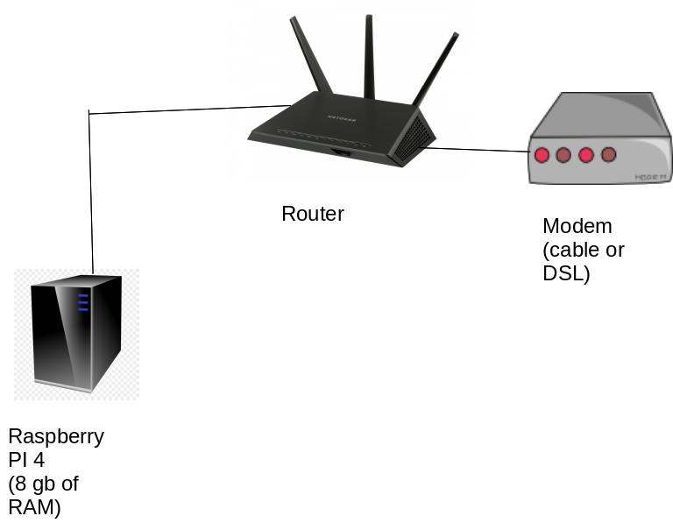
Basic Network Setup

Slide 20
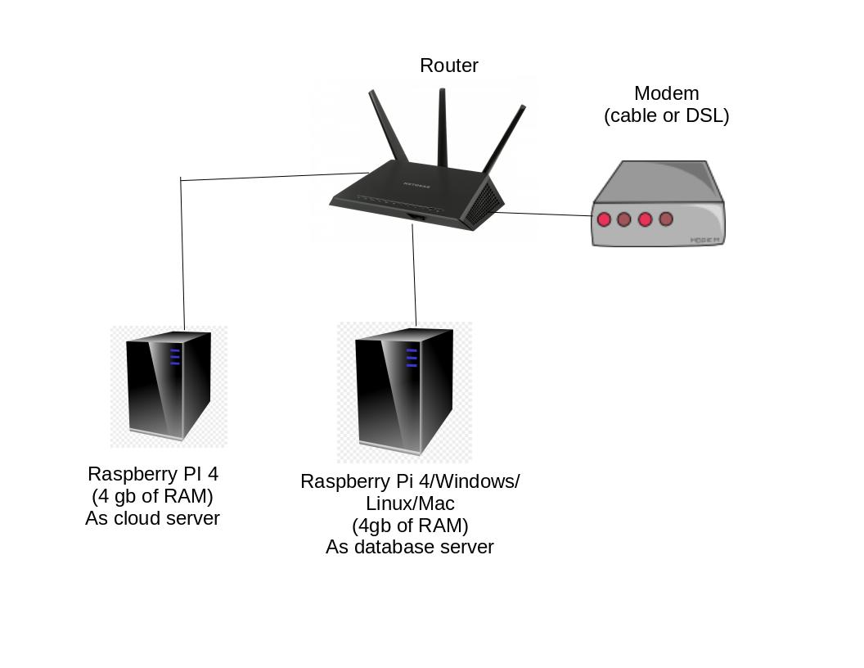
Advanced Network Setup

Slide 21
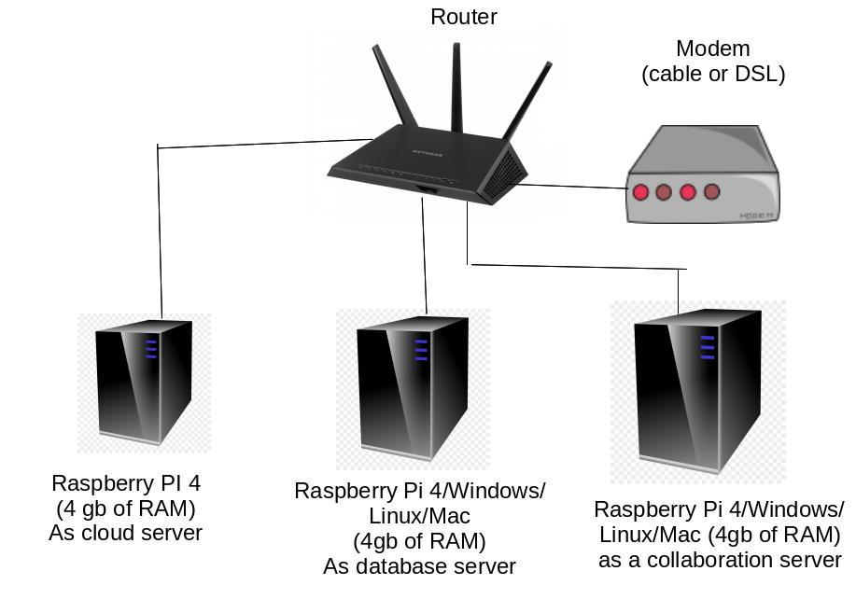
Preferred Network Setup

Slide 22
Nextcloud Application

Slide 23
History of Nextcloud
Created in Germany as an option for schools, government agencies, and businesses to manage their own cloud server that isn’t connected to American cloud services including Google, Microsoft, and Amazon

Slide 24
History of Nextcloud
Because of Government contracts in American by American cloud service companies, many EU regulations prohibit the use of cloud services such as Onedrive, AWS, and Google Cloud Services

Slide 25
Nextcloud Information
Information about Nextcloud, is available on the website:
nextcloud.com
There is an Enterprise version available for business use (fee based)
Version used in this presentation is no fee
(Nextcloud at Home)

Slide 26
Nextcloud information
Documentation is available on the website:
https://docs.nextcloud.com/server/20/admin_manual/contents.html
When Nextcloud is installed, a PDF of the manual is available on the home folder once the administrator is logged in.

Slide 27
Raspberry Pi Hardware

Slide 28
History of Raspberry Pi
Small self contained computer used to learn computer programming and electronics
Used by schools and colleges to teach
Created by a foundation in Great Britain
40 million boards have been sold
Low cost computers that are used worldwide

Slide 29
Usage of Raspberry Pi
Security systems
Robotics
Drone
Computerized lighting displays
Network security services (VPN and SSH tunnels)
Web servers
Media servers
Classic video game systems

Slide 30
Raspberry Pi Information
Website:
rasberrypi.org
Publications are available using the Readly app
Raspberry Pi has manuals that you can download for free
Most updated material for the product line does come from Great Britain
Linked-In Learning has classes on Raspberry Pi

Slide 31
Cloud Applications

Slide 32
MySQL Server History
Started as a database server by Sun
Acquired by Oracle and is supported along with their regular database server systems
MySQL is used by most social media platforms and used by NASA and Google for big data applications
Community version used is no charge

Slide 33
MySQL information
Available on the website:
https://dev.mysql.com/doc/refman/8.0/en/
This video will be working on version 8.0 of MySQL
Books are available on Amazon
Classes are available on Linked-in Learning

Slide 34
Ubuntu History
Open sourced Linux operating system created in 2004
Linux was created in 1990 by Linus Pauling
Linux follows the same processes that Unix and Xenix use but are updated to support the internet, client/server applications, and GUI (Graphical User Interfaces).

Slide 35
Ubuntu Information
Visit website:
ubuntu.com
Free pdf manual is available
Amazon has Ubuntu Server manuals, make sure they apply to version 20.4
Operating system covered is a server (not desktop)
Classes are available on Linked-In Learning

Slide 36
Ubuntu Information
Server doesn’t include a desktop
(removed to save on memory and other resources)
The cloud server application is the graphical interface and isn’t needed for this application
Commands will be used to get the system running but will not go into detail about the operating system commands.

Slide 37
Raspberry Pi Setup

Slide 38
Setup Raspberry Pi Image File
If you purchased a Raspberry Pi kit
(board, case, power supply, heat sinks, memory card, and reader)
chances are the SD card already has the Raspberry Pi image file (known as Raspian).
If this is you only computer, you will need another SD card to put the Ubuntu image file using the Raspberry Pi image file app.

Slide 39
Setup Raspberry Pi Image
Download and install the Raspberry Pi Image app from the website:
https://www.raspberrypi.com/software/
For Raspberry Pi devices, access the terminal app and type in the following:
sudo apt install rpi-imager
Once installed, select the Ubuntu 20.4 Server image
(64-bit for ARM processors)

Slide 40
Setup Raspberry Pi Image
Make sure you safely remove the SD card from computer once it has completed the installation of installing Ubuntu to the SD card

Slide 41
Install Raspberry Pi to case
4 screws are needed to install the board to the case
Heat sinks should only be applied to the processor and the RAM
Some cases have access to the SD card from the outside, some SD cards must be installed before assembling the board to the case

Slide 42
Install Fan to Raspberry Pi
Power must be turned off before installing fan to device
3 volt fan, use pin 1 for power (red cable) and pin 6 for ground (black cable)
5 volt fan, use pin 2 or 4 for power (red cable) and pin 5 for ground (black cable)
Raspberry Pi uses 40 pin diagram

Slide 43
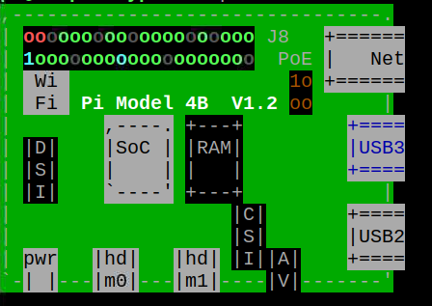
GPIO diagram
Ground
5 volts
3 volts
Can be accessed from Raspian using the command:
$pinout

Slide 44
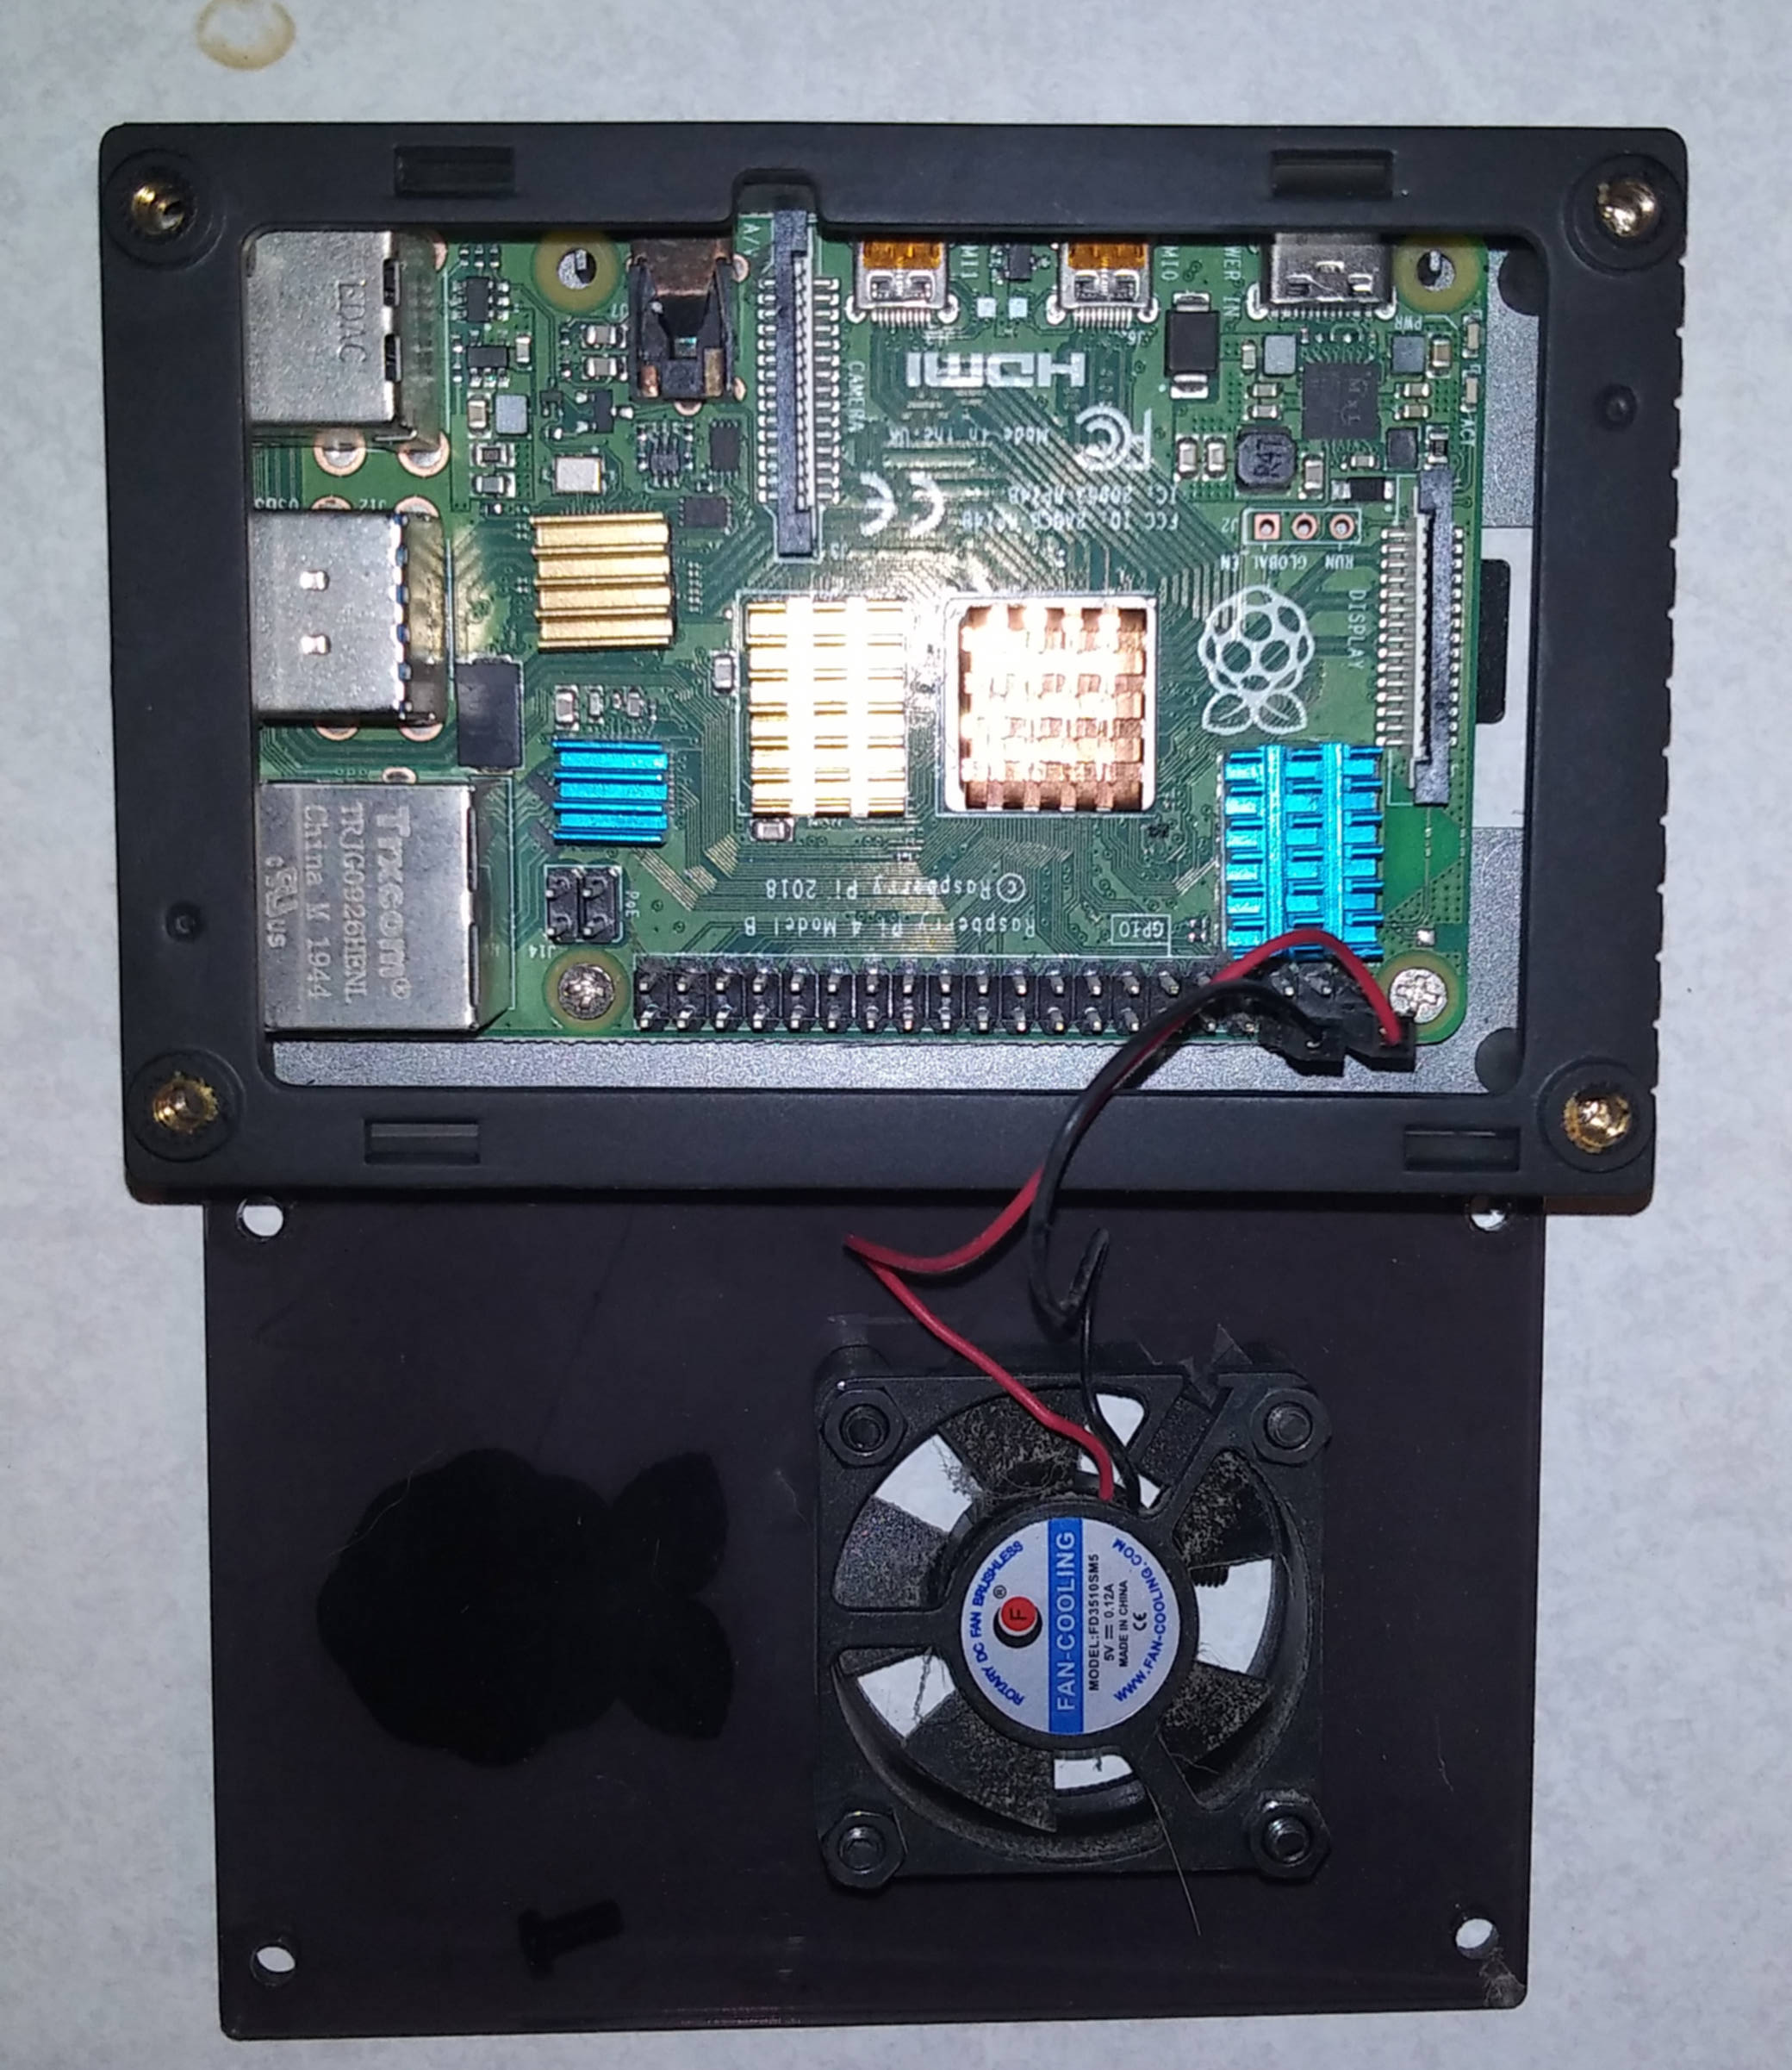
Fan connection (5 volt fan)

Slide 45
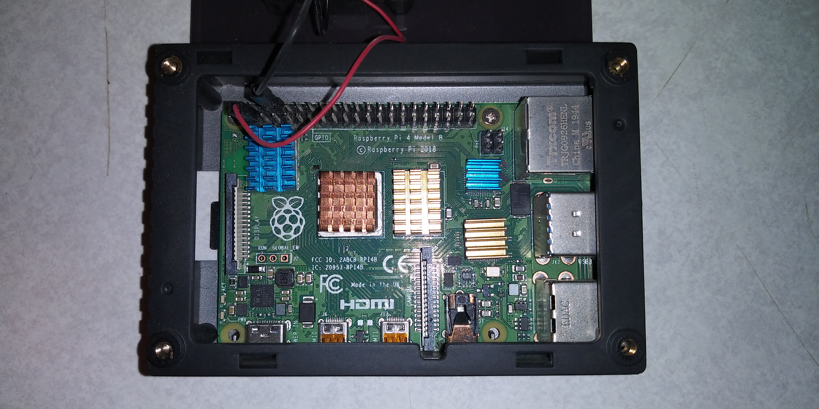
Heatsink installation (in red box)
Motherboard screws are noted in arrows
Heatsinks should be applied to the processor and RAM (solid red area).
Placing one on the wi fi can cause a short circuit and can make it difficult to access the GPIO
(see light red area).

Slide 46
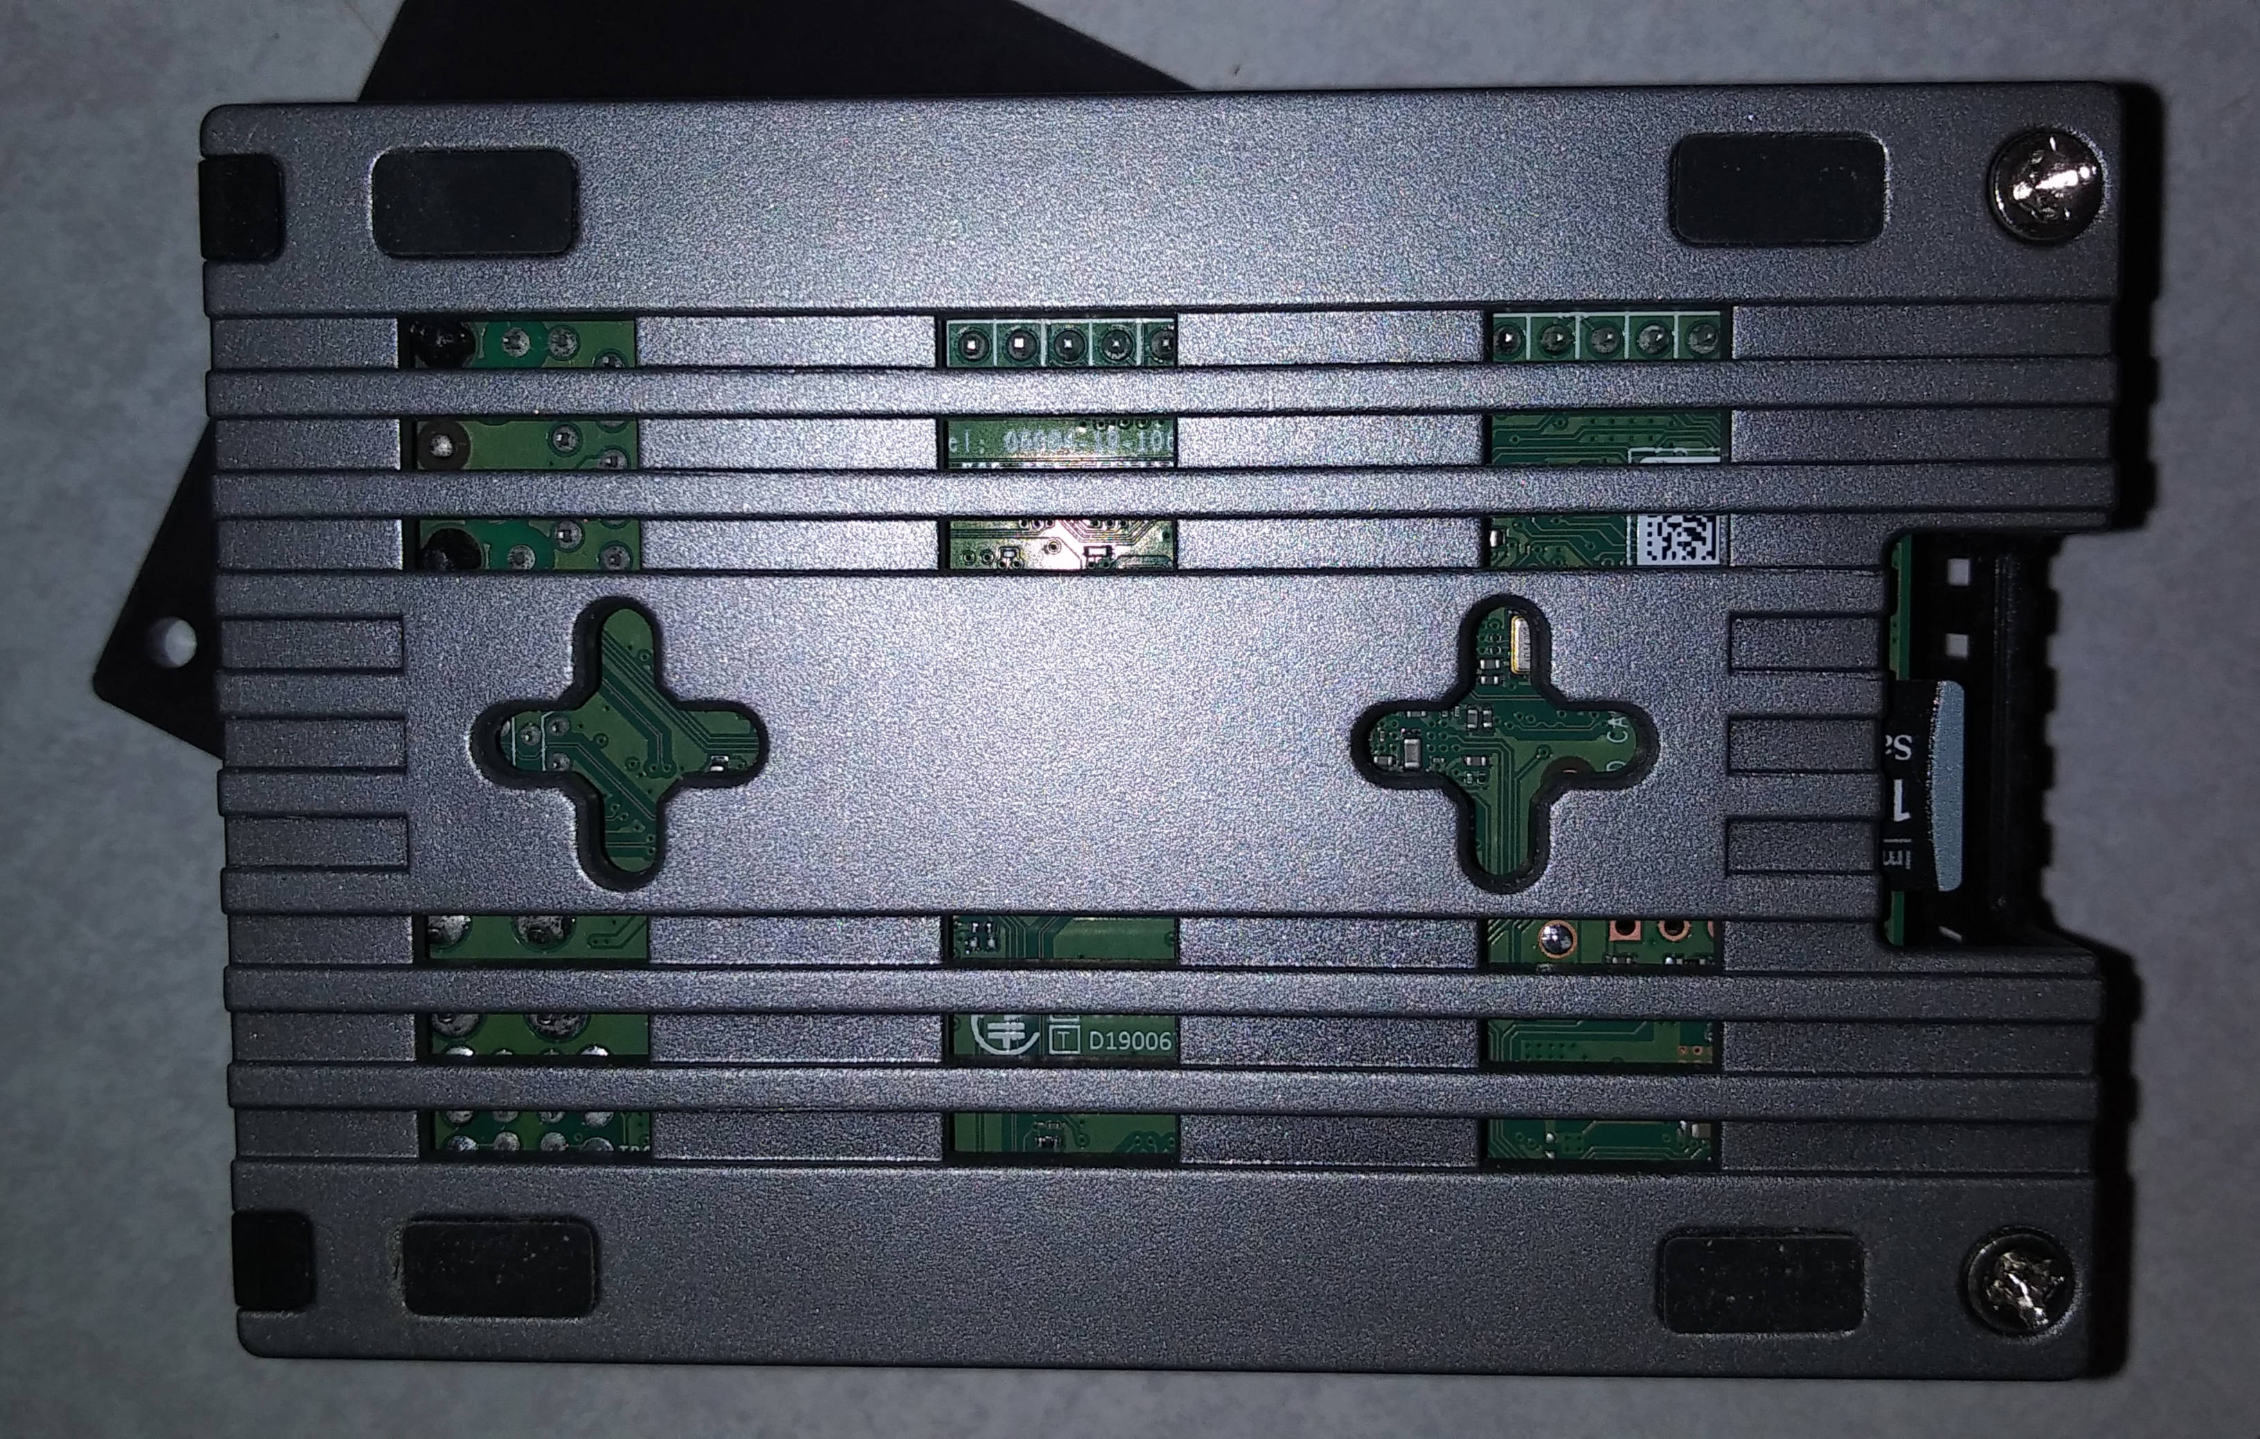
SD Card Installation
Label side down
Card only goes in one way

Slide 47
Connecting Raspberry Pi to Hardware
Connect hard drive to USB 3.0 (USB connectors colored blue)
(connect to USB hub to hard drive if it doesn’t have a power source)
Connect USB hub to USB 3.0
Connect micro hdmi cable to video port and TV
Connect ethernet cable to device as well as the network
Connect keyboard and mouse to USB 2.0 ports
Connect power cable to device
Make sure device appears on the screen

Slide 48
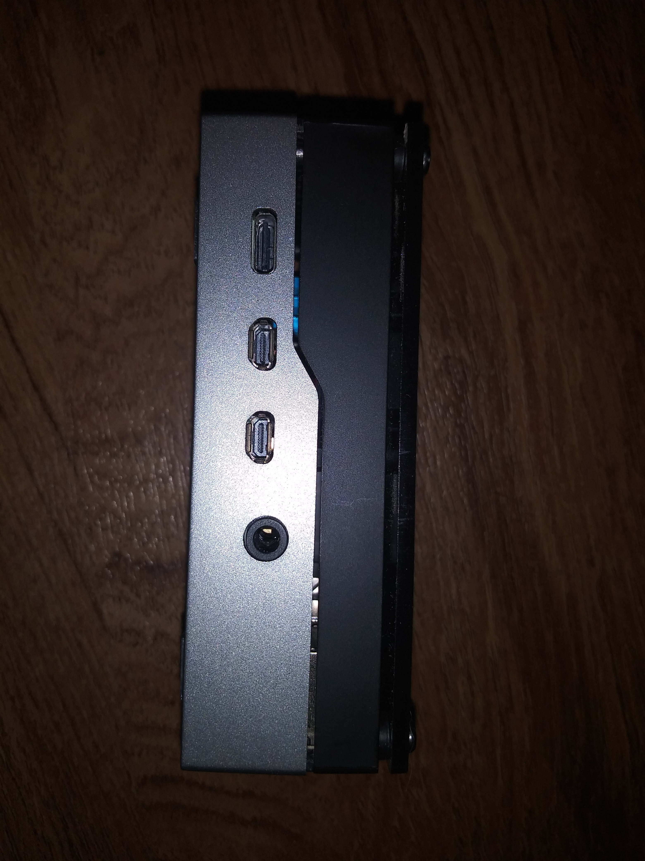
Video and Power Connectors
Power Connector
Video connectors
(HDMI 1 & 2)

Slide 49
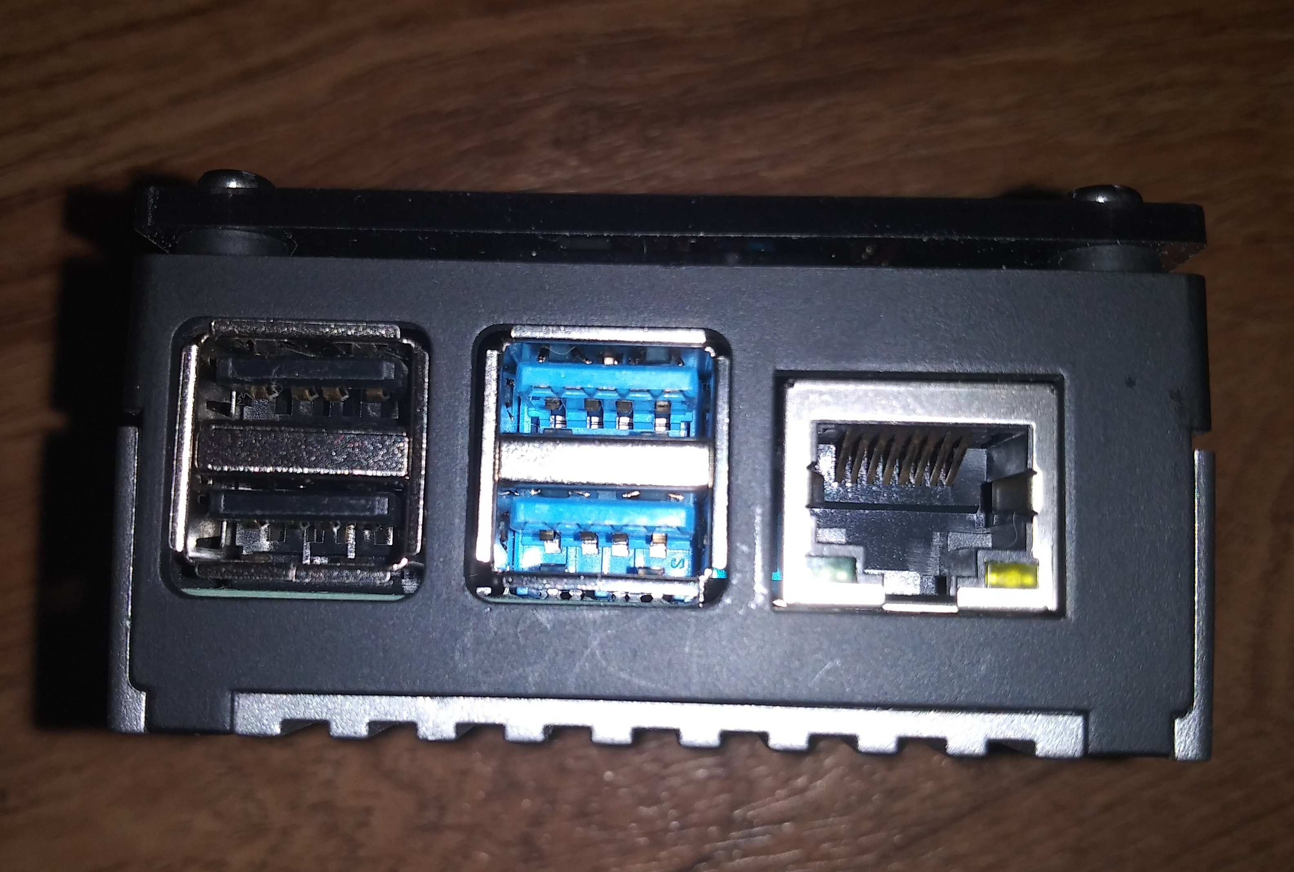
USB and Network Connections
USB 2.0
Ethernet
USB 3.0
Keyboard and mouse should connect to USB 2.0

Slide 50
Installation of Ubuntu
SD card will install operating system and additional programs
SSH (Secured Shell) will be installed
Web server (Apache2) will be installed
MySQL, PHP, and Nextcloud will be installed once the computer is booted.

Slide 51
When Ubuntu is installed on Raspberry PI
Default root user is “ubuntu”
Default password is “ubuntu”
Default password will have to be changed once you log into the system for the first time
If Ubuntu is being installed onto a device other than the Raspberry Pi, the setup wizard is more detailed.

Slide 52
If video doesn’t appear on the screen
Use a 720p or 1080p television or monitor
4k or 8k requires additional settings that are provided on support blogs but haven’t worked yet.
Use SSH from another computer to communicate with the device.

Slide 53
Logging in
Default user id is ubuntu
Default password is ubuntu. System will ask you to change the password.
(If you are installing Ubuntu from a device other than a Raspberry Pi, these settings are asked for during the installation that are added by the installer)
Logging into the computer (Raspberry Pi) from SSH with the default user id and password will require you to change the default password.

Slide 54
When logged in
Pay attention to the prompt
Additional users will be added through the Nextcloud app. It isn’t necessary to add users through Linux at this time.
Make a note of the IP address (inet) and netmask by typing in:
ip addr
If you are prompted to install app to use the ip command, type in sudo apt install (name of app) and press enter (accept installation by pressing Y and press enter). Once installed, type in ip addr
eth0 is the settings

Slide 55
Updating
Type in the following:
sudo apt update
If nothing installs (but upgrade options exist) then type in the following:
sudo apt upgrade

Slide 56
Edit network settings
Type in the following:
cd /etc/netplan
Look for file containing .yaml
Create a copy by typing in the following:
sudo mv (name of file).yaml to (name of file).back
Type in the following:
sudo nano (name of file). yaml

Slide 57
.yaml file
network:
ethernets:
eth0:
addresses:
- (ip address)
gateway4: (ip address of router)
nameservers:
addresses: [(ip address of router)]

Slide 58
Save file
Press control x
Press y to save and press enter
Once you are out of nano, type in the following:
sudo netplan apply
Correct any errors (if noted)
If the prompt returns, network settings were updated and applied to the computer

Slide 59
Updating Ubuntu
Type in the following:
sudo apt update
You may have to use:
sudo apt upgrade
to update features
Select y and press enter for updates
In some cases, you may have to restart the computer

Slide 60
Using SSH
Known as Secured Shell (a replacement for tty)
Provides an encrypted remote connection to the computer for administrative purposes.
Can be on any Linux, Windows, or Mac computer
If your device is connected to a 4k or 8k television and you can’t see anything on the screen, this option will give you access to it.
Provides an encrypted remote connection to the computer for administrative purposes.

Slide 61
SSH Installation
Server is automatically installed in Ubuntu
Putty can be used to access the computer via SSH
SSH client can be installed in Windows 10 or 11 when using the Linux Subsystem option.
WinSCP (Windows), Termius (Windows, Android, Apple)
Some are free, some are subscriber based.

Slide 62
Access through SSH
Type in the following:
ssh ubuntu@ip address
Select yes to add encryption key
Enter in password and press enter.

Slide 63
Add Time Zone to Raspberry Pi
Type in the following:
timedatectl list-timezones
View the list for time zones
Type in the following:
sudo timedatectl set-timezone (your_time_zone)

Slide 64
What is PHP?
PHP (hypertext preprocessor) is the scripting language used for the Nextcloud web app
Used to build and program many websites
Work with MySQL(?)
As of Nextcloud version 22, PHP 8.0 is used
(PHP 8.1 is available but will not work with Nextcloud)

Slide 65
To install PHP
Type in the following:
sudo apt install php8.0
If you are using other applications that aren’t compatible with php 8.0 (such as mysqladmin) php7.4 can be installed as well
Php 8.0 is designed to work with the security features that are used with MySQL version 8

Slide 66
Verify PHP is working
Type in the following:
php -v

Slide 67
To install MySQL
Type in the following:
sudo apt install mysql-server
Version 8.0 should install
Type in the following:
sudo mysql_secure_installation
Pick an option for password security
Select password for root user
Root user for MySQL is a separate user from the Ubuntu root user

Slide 68
Install ufw
Ufw – Universal Firewall is used for security purposes
The firewall controlls incoming traffic
Once installed only ports needed for services on the server will be enabled
Install using the following:
$sudo apt install ufw
Once installed, enter the following:
$sudo ufw enable

Slide 69
Install ufw
Port | Service
SSH | 22
HTTP | 80
HTTPS | 443
Ports to enable

Slide 70
Activate ufw ports
Enter the following:
$sudo ufw allow (port number)
Port numbers 22, 80, and 443 should be added

Slide 71
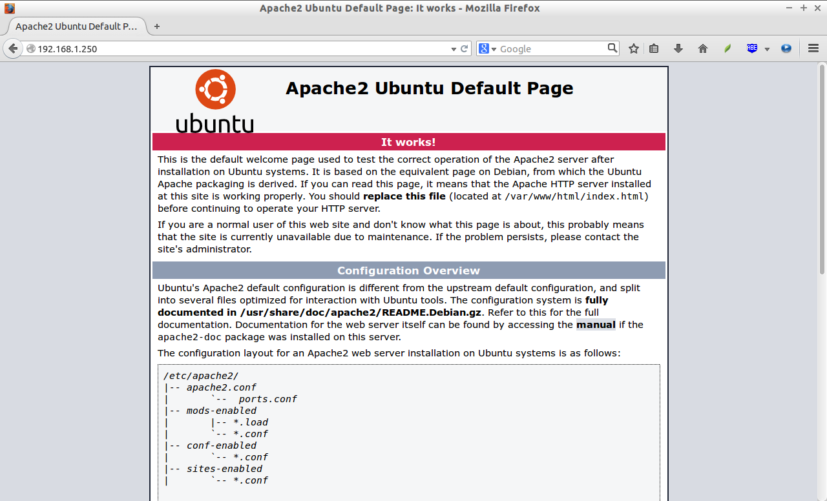
Check web server
From a web browser, type in the following:
http://localhost

Slide 72
File locations and folders

Slide 73
Web folder files
Reside in folder:
/var/www/html
Configuration files reside in:
/etc/apache2

Slide 74
MySQL file reside in:
/var/lib/mysql (linux)

Slide 75
Testing MySQL Server
Type in the following:
mysql -u root -p
Enter the root password
MySQL information should appear on the screen
Log off by typing in:
exit

Slide 76
Setup external hard drive
Locate hard drive by typing in the following:
sudo fdisk -l
If hard drive is identified as NTFS, hard drive must be formatted to ext4 using:
sudo mkfs.ext4 (hard drive location)
Depending the size of hard drive, this may take some time

Slide 77
Mount hard drive to Raspberry Pi
Type in the following:
lsblk
This will display the device information
Type in the following:
sudo mkdir /media/external
This will create the mount point

Slide 78
Mount hard drive to Raspberry Pi
Type in the following:
blkid /dev/sdXX
Note the UUID
Edit the file:
sudo nano /etc/fstab
After it is edited, type in:
sudo mount -a
If there are no errors, device will be mounted and stay that way when device is rebooted

Slide 79
Copy database table to external hard drive
Log into MySQL by typing in the following:
mysql -u root -p
Enter the root password for mysql server
Type in the following:
SELECT @@datadir;
MySQL will display the folder

Slide 80
Copy database table to external hard drive
Type in the following:
sudo systemctl stop mysql
Create folder by typing in:
sudo mkdir /media/external/datatables
Type in the following:
sudo rsync -av /var/lib/mysql /media/external/datatables

Slide 81
Copy database table to external hard drive
Type in the following:
sudo mv /var/lib/mysql /var/lib/mysql.bak
Edit:
sudo nano /etc/mysql/mysql.conf.d/mysqld.cnf
Change the datadir line to:
datadir=/media/external/datatables
Restart MySQL server:
sudo systemctl start mysql
If there are no error messages displayed, MySQL server is running

Slide 82
Backup SD card to external hard drive
Create the following folder:
sudo mkdir /media/external/sdimage
Type in the following:
sudo dd bs=4M if=/dev/mmcblk0p2 of=/media/exerternal/sdimage/raspbian.img
“/dev/mmcblk0p2” is the device location of the SD card
(identified by /)

Slide 83
Questions
Use the email form on the website if you have any questions

